Slide 1
BITS Pilani
Department of Computer Science

Slide 2
ES ZC481 / IS ZC467, COMPUTER NETWORKS
Lecture No. 3,4 & 5

Slide 3
Application layer Protocols

Slide 4
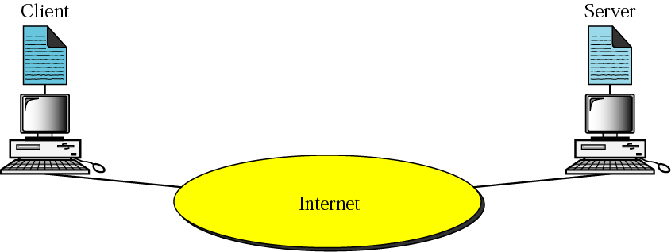
Client-server model
To make any use of the Internet, application programs should run on the two endpoints of a network connection.
The applications are the entities that communicate with each other to exchange services
“Client” applications request service
“Server” applications provide service.

Slide 5
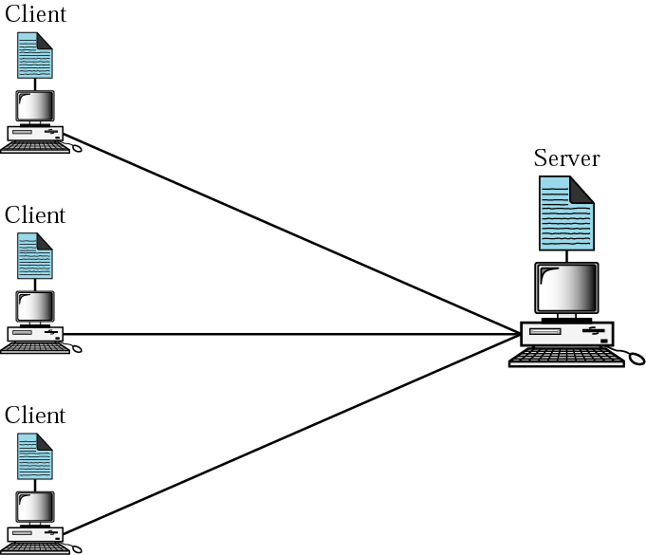
Client-Server Relationship: Many-to-One
Servers
  Run all the time (i.e. infinite)
  Provide service to any client
  Typically specialize in providing a certain type of service, e.g. Mail.
  Listen to a well-known port and passively open connection.
Clients
  Run when needed, then terminate (i.e. finite)
  Actively Open TCP or UDP connection with Server’s socket.

Slide 6
Client Server Model
The Client needs to know the existence and the address of the server.
However, the server does not need to know the existence or address of the client prior to the connection.
Once a connection is established, both sides can send and receive information.

Slide 7
How to establish a connection?
Both client and server will construct a socket.
A socket is one end of an inter-process communication channel.
The process to establish a socket on the client side is different than the process to establish a socket on the server side.

Slide 8
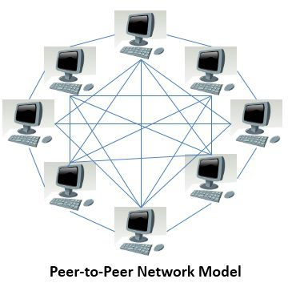
What is Peer-to-Peer?
A model of communication where every node in the network acts alike.
As opposed to the Client-Server model, where one node provides services and other nodes use the services.

Slide 9
Advantages of P2P Computing
No central point of failure
Scalability
  Since every peer is alike, it is possible to add more peers to the system and scale to larger networks.

Slide 10
Disadvantages of P2P Computing
Decentralized coordination
  How to keep global state consistent?
All nodes are not created equal.
  Computing power, bandwidth have an impact on overall performance.

Slide 11

HTTP overview
HTTP: hypertext transfer protocol
client/server model
  client: browser to request & receive Web objects
  server: Web server sends objects in response to requests
HTTP 1.0: RFC 1945
HTTP 1.1: RFC 2068 (persistent TCP)
HTTP request
PC running
Explorer
HTTP response
HTTP request
Server
running
Apache Web
server
HTTP response
Mac running
FireFox

Slide 12
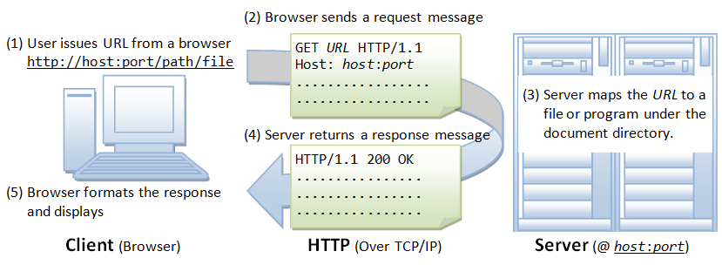
HTTP Overview

Slide 13
HTTP overview (continued)
Uses TCP:
1. client initiates TCP connection to server,port 80
2. server accepts TCP connection from client
3. HTTP (application-layer) messages exchanged between HTTP client and HTTP server
4. TCP connection closed
HTTP is “stateless”
server maintains no information about past client requests
Protocols that maintain “state” are complex!
history (state) is maintained
if server/client crashes, views of “state” may be inconsistent, must be reconciled
state is added via ‘cookies’
A ‘state’ is information kept in memory
of a host, server or router to reflect
past events: such as routing tables,
data structures or database entries
2: Application Layer

Slide 14
HTTP connections
I. Nonpersistent HTTP
At most one object( image or videos) is sent over a TCP connection. Used in HTTP/1.0
II. Persistent HTTP
Multiple objects can be sent over single TCP connection. Used in HTTP/1.1 by default:
  A. persistent with pipelining
  B. persistent without pipelining
2: Application Layer

Slide 15
Nonpersistent HTTP
User enters URL http://www.someSchool.edu/someDepartment/home.index
1a. HTTP client initiates TCP connection to someSchool.edu : port 80
1b. HTTP server @ someSchool.edu port 80. “accepts” connection, notifying client
2. HTTP client sends request message (containing URL) into TCP connection. Message indicates that client wants object someDepartment/home.index
3. HTTP server receives request message, sends response message containing requested object
time
2: Application Layer

Slide 16
I. Nonpersistent HTTP (cont.)
4. HTTP server closes TCP connection.
5. HTTP client receives response message containing html file, displays html. Parsing html file, finds 10 referenced jpeg objects
time
6. Steps 1-5 repeated for each of 10 jpeg objects
2: Application Layer

Slide 17
I. Non-Persistent HTTP: Response time
Definition of RTT: time to send request from client to server and back.
Response time:
one RTT to initiate TCP connection
one RTT for HTTP request and first few bytes of HTTP response to return
file transmission time
total = 2RTT+transmit time
initiate TCP
connection
RTT
request
file
RTT
time to
transmit
file
file
received
time
time
2: Application Layer

Slide 18
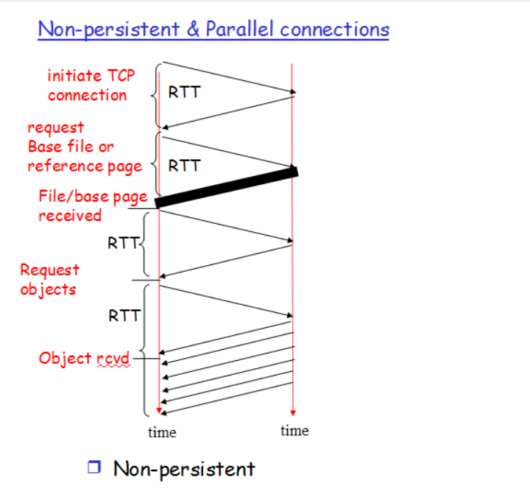
With parallel connection Non-Persistent

Slide 19
Persistent HTTP
I. Nonpersistent HTTP issues:
requires 2 RTTs per object
OS overhead for each TCP connection
browsers often open parallel TCP connections to fetch referenced objects
II. Persistent HTTP
server leaves connection open after sending response
subsequent HTTP messages between same client/server sent over open connection
A. Persistent without pipelining:
client issues new request only when previous response has been received
one RTT for each referenced object
B. Persistent with pipelining:
default in HTTP/1.1
client sends requests as soon as it encounters a referenced object
as little as one RTT for all the referenced objects
2: Application Layer

Slide 20
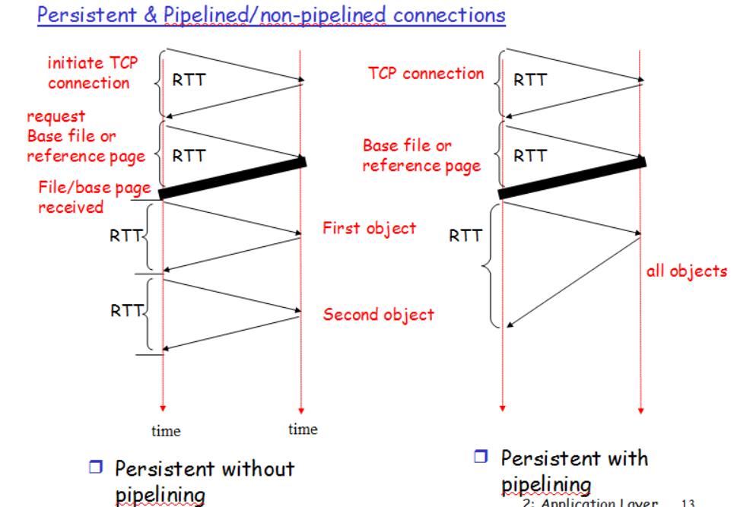

Slide 21
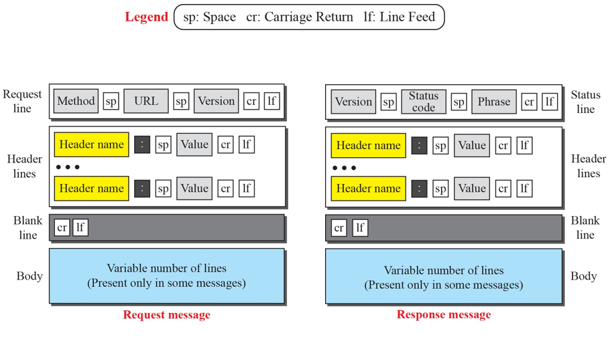
HTTP Request and Response

Slide 22
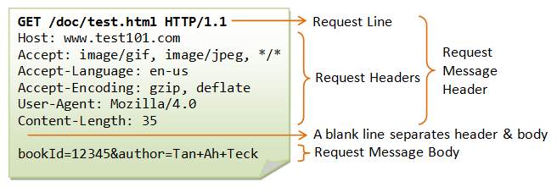
sample HTTP request message:

Slide 23
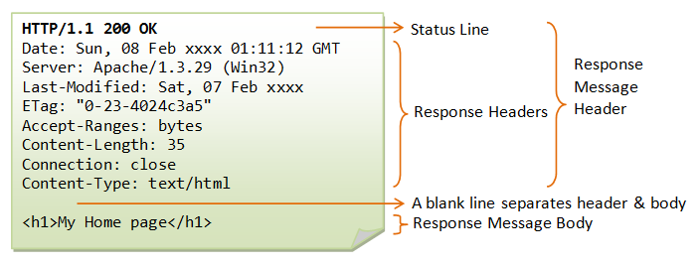
Sample HTTP response message:

Slide 24
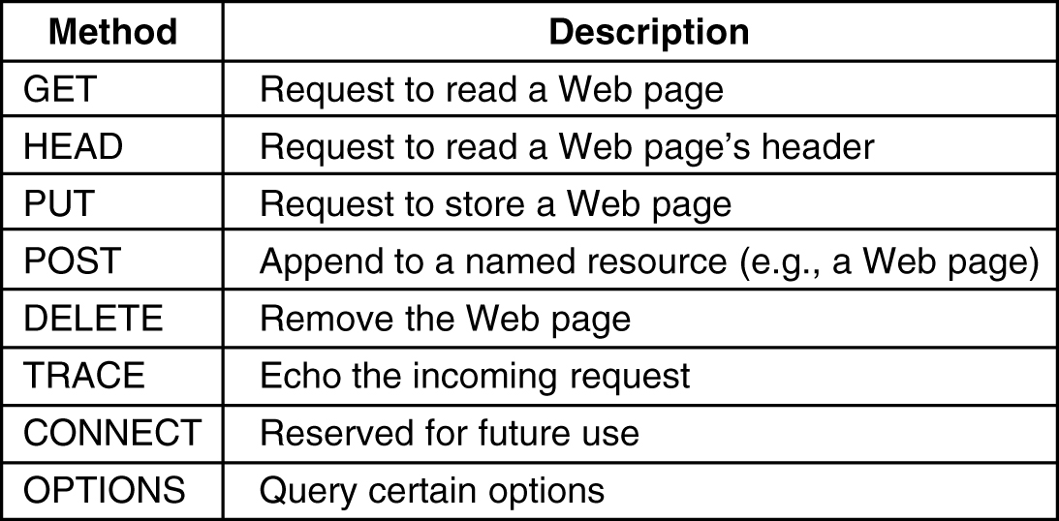
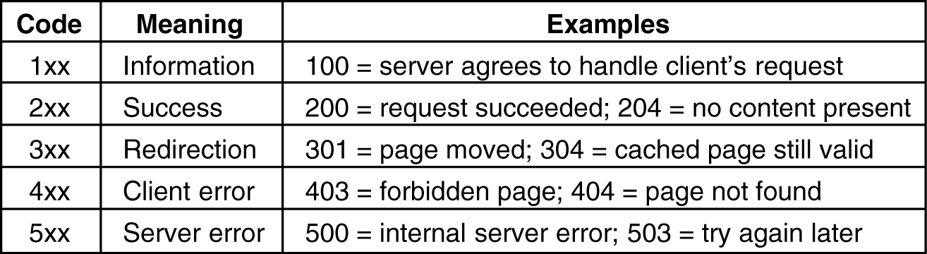
HTTP - methods
HTTP - responses

Slide 25
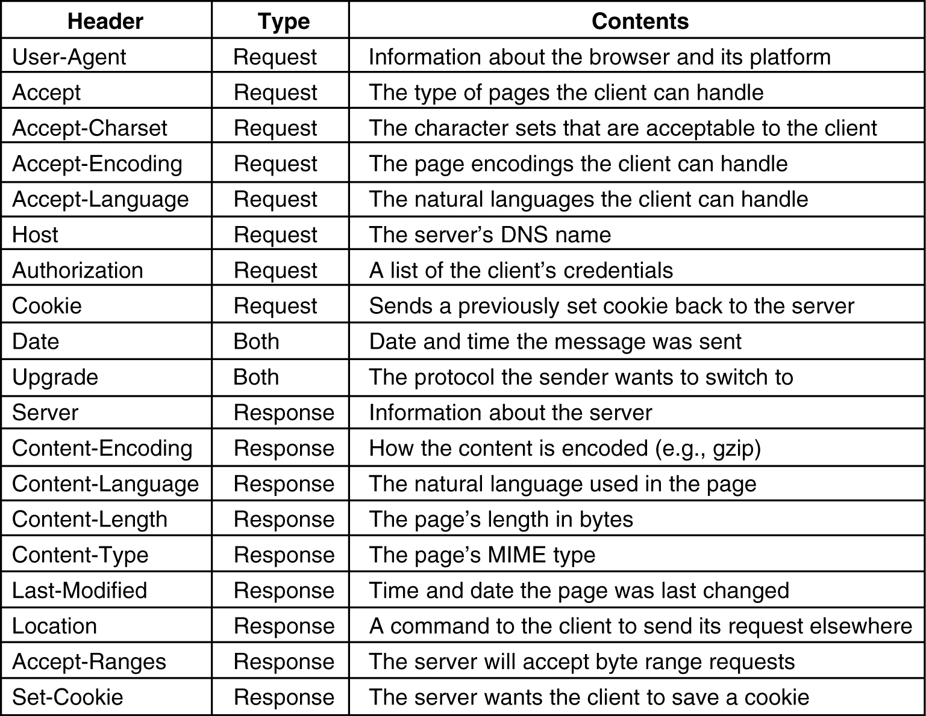
HTTP - Some Message Headers

Slide 26
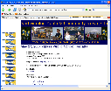
Web caches (proxy servers)
Goal: satisfy client request without involving origin server
user sets browser:
Web accesses via cache
browser sends all HTTP requests to cache
  object in cache: cache returns object
  else cache requests object from origin server, then returns object to client
  Cache keeps copy of object for future use
origin
server
Proxy
server
HTTP request
HTTP request
client
HTTP response
HTTP response
HTTP request
HTTP response
client
origin
server
- Can all objects be cached?
- Proxy vs. local browser cache
2: Application Layer

Slide 27
More about Web caching
Cache acts as both client and server
Typically, cache is installed by ISP (university, company, residential ISP)
Why Web caching?
1. Reduce response time for client request
2. Reduce traffic on an institution’s access link.
2: Application Layer

Slide 28
Caching example
origin
servers
Assumptions
average object size = 100k bits
avg. request rate from institution’s browsers = 15 req/sec
Internet delay= 2 sec
Consequences
utilization on LAN = actual output/ maximum available= 15%
utilization on access link = 100%
total delay = Internet delay + access delay + LAN delay
= 2 sec + 1 seconds + .15seconds
=3.15 sec
public
Internet
1.5 Mbps
access link
institutional
network
10 Mbps LAN
2: Application Layer

Slide 29
Caching example (cont)
origin
servers
one solution: install cache
suppose hit rate is 0.4
consequence
40% requests will be satisfied almost immediately (say within 10 msec)
60% requests satisfied by origin server
utilization of access link reduced to 60%, resulting in negligible delays (say 10 msec)
total avg delay = Internet delay + access delay + LAN delay = .6*(2.01) secs + .4*milliseconds < 1.4 secs
public
Internet
1.5 Mbps
access link
institutional
network
10 Mbps LAN
institutional
cache
2: Application Layer

Slide 30
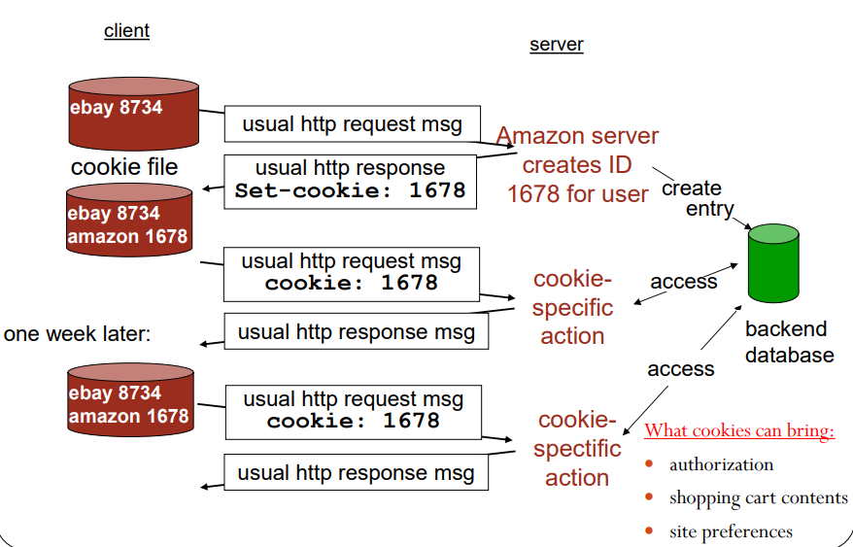
Cookies: Keeping State
small piece of data sent from a website and stored on the user's computer by the user's web browser while the user is browsing.
designed to be a reliable mechanism for websites to remember stateful information (such as items added in the shopping cart in an online store) or to record the user's browsing activity

Slide 31
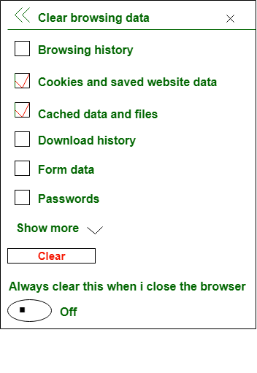
Cookies Vs cache
The main difference between Cache and Cookie is that, Cache is used to store online page resources during a browser for the long run purpose or to decrease the loading time.
On the other hand, cookies are employed to store user choices such as browsing session to trace the user preferences

Slide 32
Questions : Assume that you have base HTML file with 30 embedded images, images & base file are small enough to fit in one TCP segment. How many RTT are required to retrieve base file & images under-following condition :
(i) Non-Persistent connection without parallel connection
(ii) Non-persistent connection with 10 parallel connection
(iii) Persistent connection without pipe-lining
(iv) Persistent connection with pipe-lining
(Assume RTT dominates all other time)

Slide 33
Explanation :
2RTT is the initial required connection one for TCP connection and one for HTML base file.
Total time = 2RTT + transmit time
(i) Non-Persistent connection with no parallel connection :
Here for each image 2 RTT are required one for TCP connection and one for image to send.
So transmit time for 30 images = 2*(30 RTT) = 60 RTT
Total time = 2 RTT+60 RTT = 62RTT
(ii) Non-persistent connection with 10 parallel connection :
Here 10 images can be send simultaneously.
So for 30 images it required -> 2*(30/10) = 6RTT
Total time = 2 RTT + 6 RTT = 8RTT
(iii) Persistent connection without pipelining :
Here HTTP connection is required again and again.
So for 30 images it requires -> 30 RTTs
Total time = 2 RTT + 30 RTT = 32RTT
(iv) Persistent connection with pipe-lining :
Since it is Persistent connection TCP connection is not required again and again.
Pipe-lining means in one packet only images which can fit, can be send.
In Pipe-lining connection we can send all images in 1RTT.
Total time = 2 RTT + 1 RTT = 3RTT

Slide 34

Electronic mail
outgoing
message queue
Three major components:
user agents
mail servers
simple mail transfer protocol: SMTP
User Agent
a.k.a. “mail reader”
composing, editing, reading mail messages
e.g., Outlook, Thunderbird, iPhone mail client
outgoing, incoming messages stored on server
user mailbox
user
agent
mail
server
user
agent
SMTP
mail
server
user
agent
SMTP
SMTP
user
agent
mail
server
user
agent
user
agent
Application Layer
2-<number>

Slide 35
Electronic mail: mail servers
mail servers:
mailbox contains incoming messages for user
message queue of outgoing (to be sent) mail messages
SMTP protocol between mail servers to send email messages
  client: sending mail server
  “server”: receiving mail server
user
agent
mail
server
user
agent
SMTP
mail
server
user
agent
SMTP
SMTP
user
agent
mail
server
user
agent
user
agent
Application Layer
2-<number>

Slide 36


Scenario: Alice sends message to Bob
1) Bob uses UA to compose message “to” bob@someschool.edu
2) Bob’s UA sends message to her mail server; message placed in message queue
3) client side of SMTP opens TCP connection with Alice’s mail server
4) SMTP client sends Bob’s message over the TCP connection
5)Alice’s mail server places the message in Bob’s mailbox
6) Alice’s invokes his user agent to read message
user
agent
mail
server
user
agent
1
mail
server
2
3
4
6
Bob’s mail server
5
Alice’s mail server
Application Layer
2-<number>

Slide 37
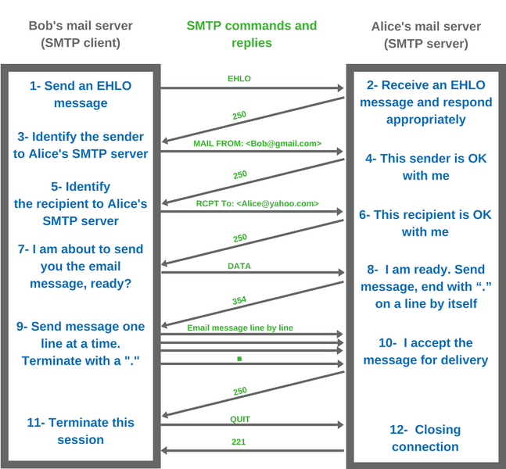

Slide 38
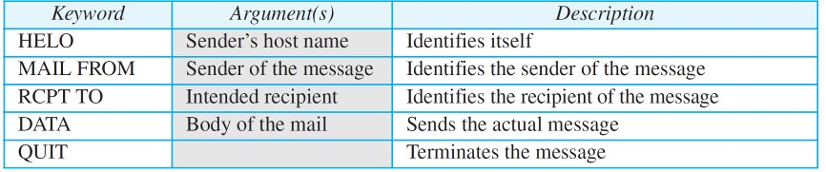
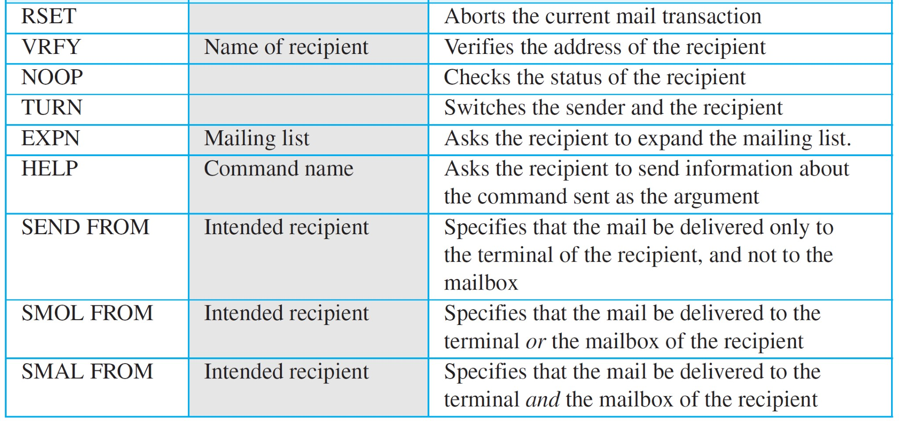
SMTP Commands

Slide 39
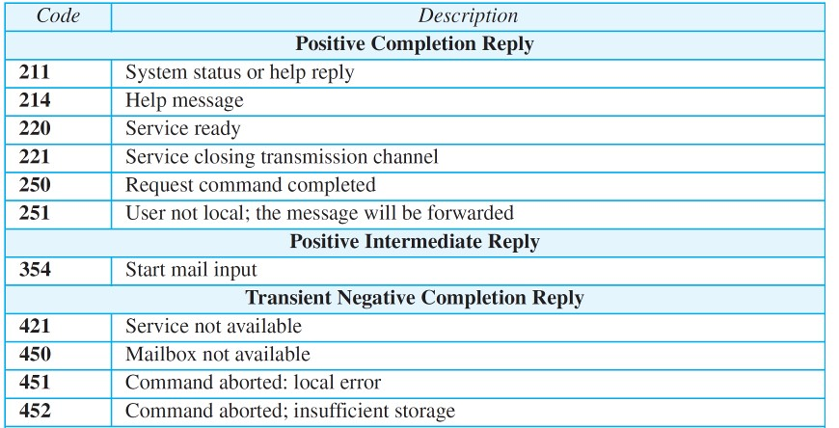
SMTP Responses

Slide 40
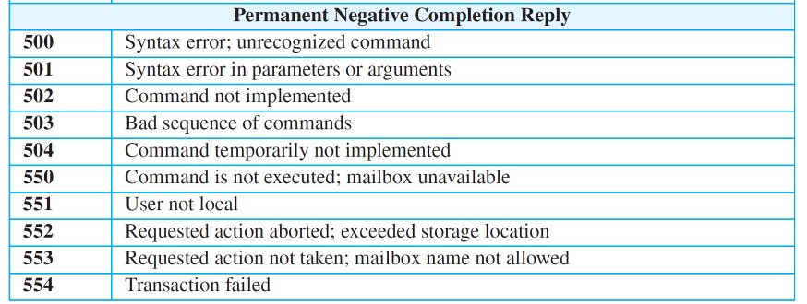
Continued..

Slide 41
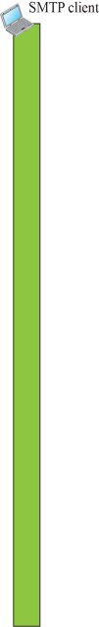
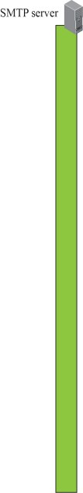
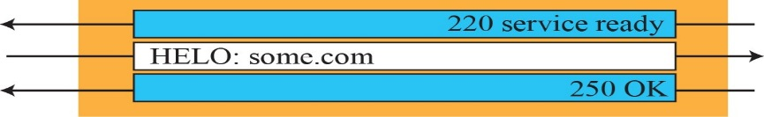

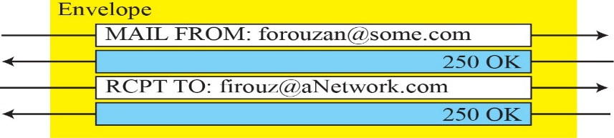
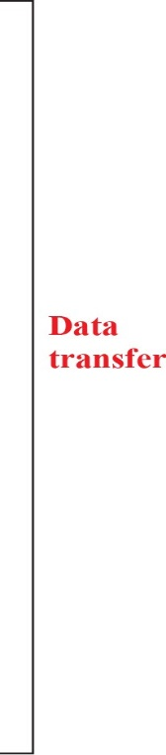
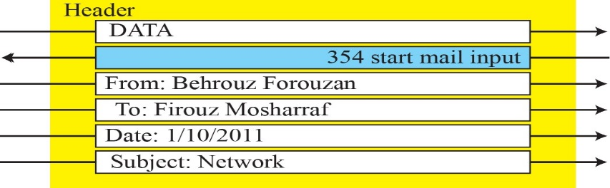
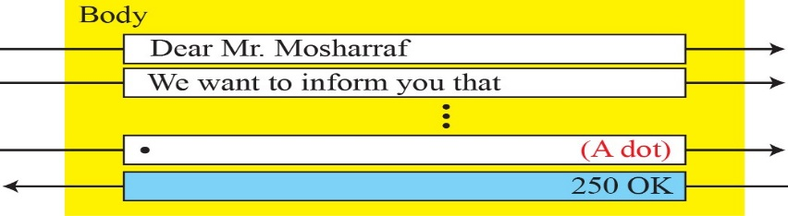
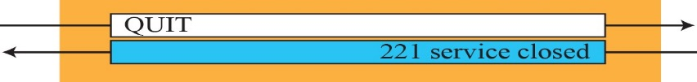

An Example

Slide 42
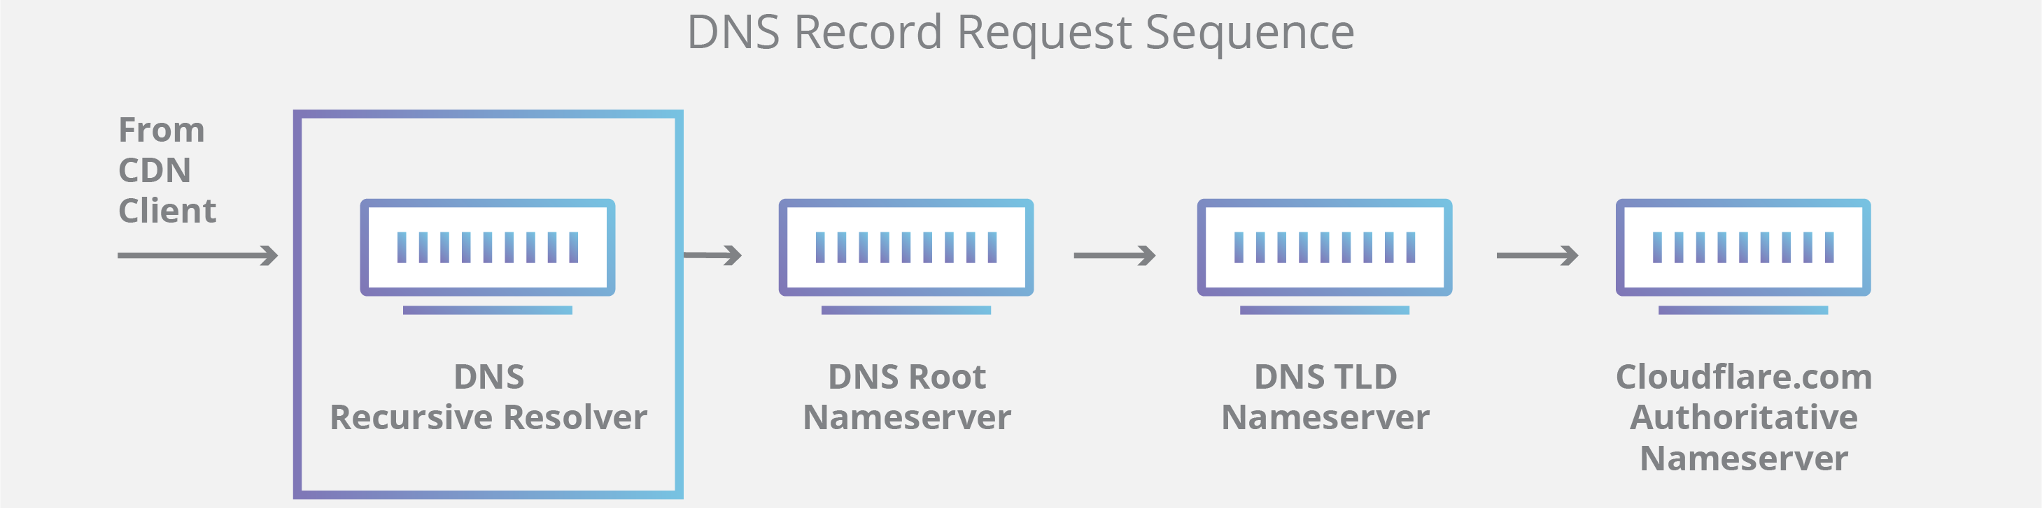
DNS: domain name system
people: many identifiers:
  SSN, name, passport #
Internet hosts, routers:
  IP address (32 bit) - used for addressing datagrams
  “name”, e.g., www.yahoo.com - used by humans
Q: how to map between IP address and name, and vice versa ?
Domain Name System:
distributed database implemented in hierarchy of many name servers
application-layer protocol: hosts, name servers communicate to resolve names (address/name translation)
  note: core Internet function, implemented as application-layer protocol
  complexity at network’s “edge”
Application Layer
2-<number>

Slide 43
DNS: a distributed, hierarchical database
Root DNS Servers
…
…
com DNS servers
org DNS servers
edu DNS servers
yahoo.com
DNS servers
amazon.com
DNS servers
pbs.org
DNS servers
poly.edu
DNS servers
umass.edu
DNS servers
client wants IP for www.amazon.com; 1st approx:
client queries root server to find com DNS server
client queries .com DNS server to get amazon.com DNS server
client queries amazon.com DNS server to get IP address for www.amazon.com
Application Layer
2-<number>

Slide 44
TLD, authoritative servers
top-level domain (TLD) servers:
  responsible for com, org, net, edu, aero, jobs, museums, and all top-level country domains, e.g.: uk, fr, ca, jp
  Network Solutions maintains servers for .com TLD
  Educause for .edu TLD
authoritative DNS servers:
  organization’s own DNS server(s), providing authoritative hostname to IP mappings for organization’s named hosts
  can be maintained by organization or service provider
Application Layer
2-<number>

Slide 45
Local DNS name server
does not strictly belong to hierarchy
each ISP (residential ISP, company, university) has one
  also called “default name server”
when host makes DNS query, query is sent to its local DNS server
  has local cache of recent name-to-address translation pairs (but may be out of date!)
  acts as proxy, forwards query into hierarchy
Application Layer
2-<number>

Slide 46
DNS name resolution example
root DNS server
host at cis.poly.edu wants IP address for gaia.cs.umass.edu
2
3
TLD DNS server
iterated query:
contacted server replies with name of server to contact
“I don’t know this name, but ask this server”
4
5
local DNS server
dns.poly.edu
1
8
7
6
authoritative DNS server
dns.cs.umass.edu
requesting host
cis.poly.edu
gaia.cs.umass.edu
Application Layer
2-<number>

Slide 47
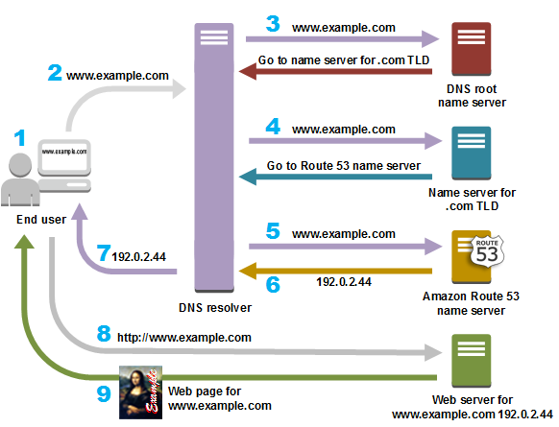

Slide 48
File Transfer Protocol (FTP)
File Transfer Protocol (FTP) is the standard mechanism provided by TCP/IP for copying of any kind of files from one host to another.
Defined in RFC 959 (1985).
FTP uses the services of TCP. It needs two TCP connections.
The well-known TCP port 21 is used for the control connection and the well-known port 20 for the data connection.
It is mainly used for transferring the web page files from their creator to the computer that acts as a server for other computers on the internet.
It is also used for downloading the files to computer from other servers.

Slide 49
Why do we need a FTP Service?
Purpose: To Transfer files between two computers
Goals of FTP Service
  Promote sharing of files (programs and/or data)
  Encourage indirect/implicit use of remote computers
  Shield users from variations in file storage among hosts
  Transfer data reliably and efficiently

Slide 50




Problems of File Transfer
At first, file transfer may seem simple
Heterogeneous systems use different:
  Operating Systems
  Character Sets
  Naming Conventions
  Directory Structures
  File Structures and Formats
FTP needs to address and resolve these problems

Slide 51
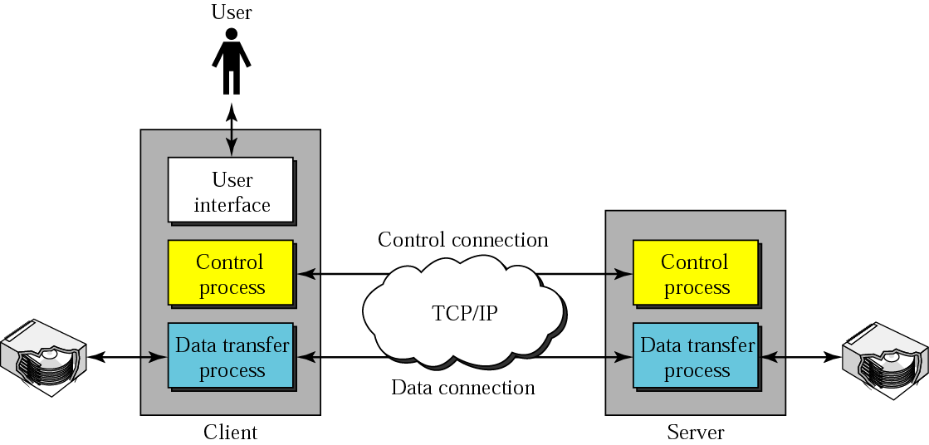
FTP operation
File transfer

Slide 52
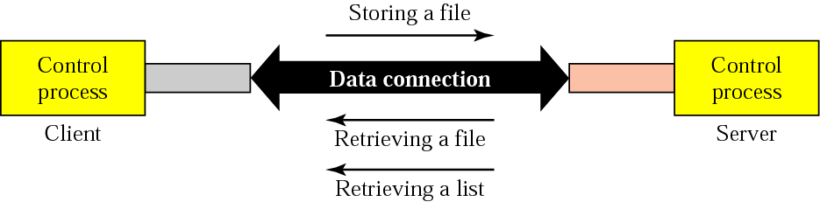
FTP – the file transfer proccess

Slide 53
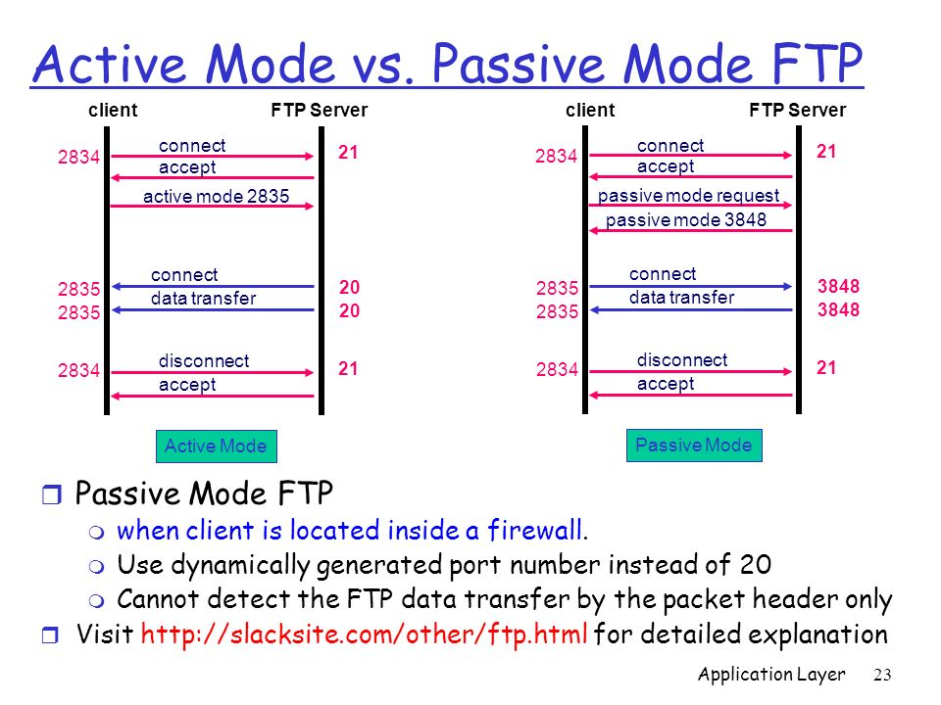

Slide 54
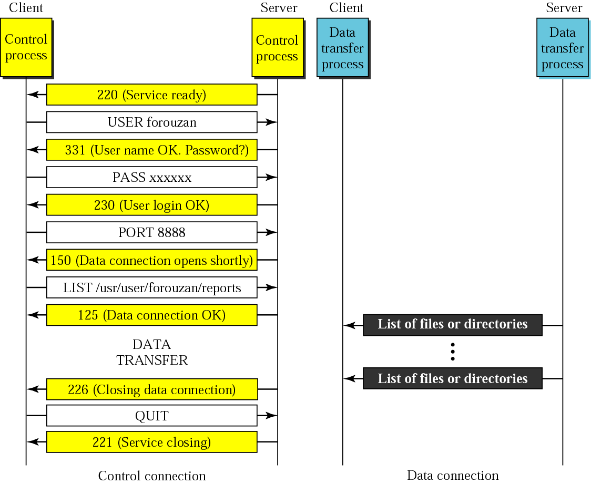
FTP – an example session

Slide 55
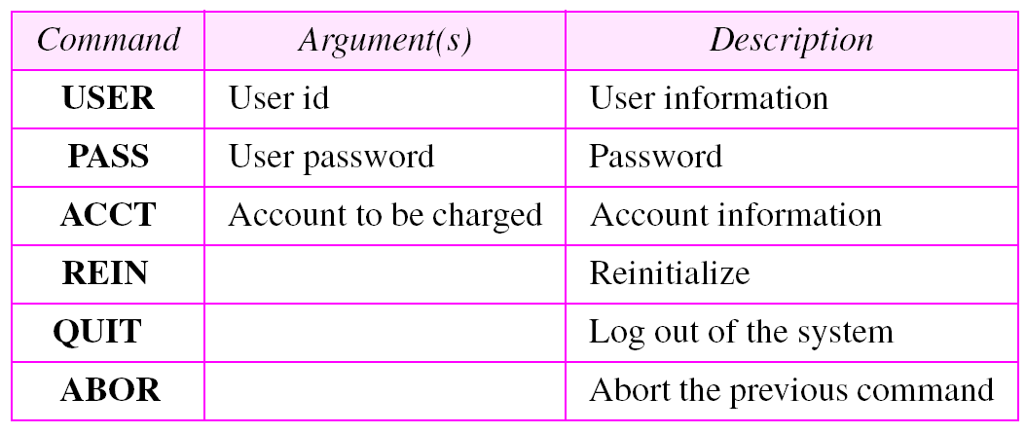
FTP - access commands

Slide 56
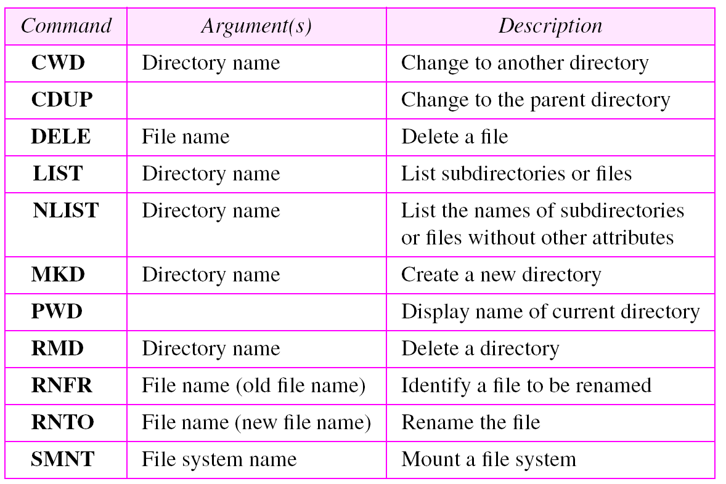
FTP – file management commands

Slide 57
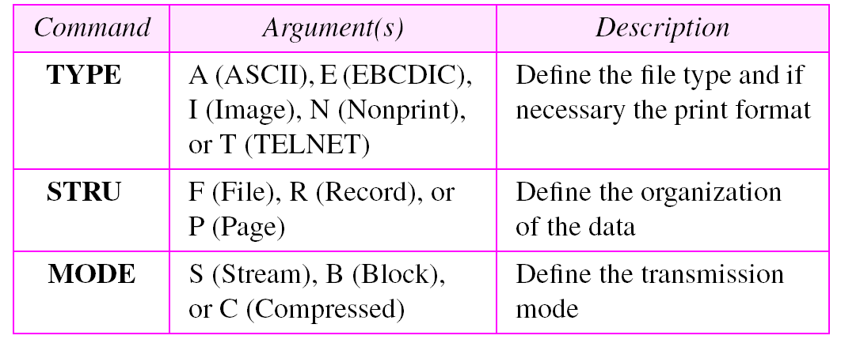
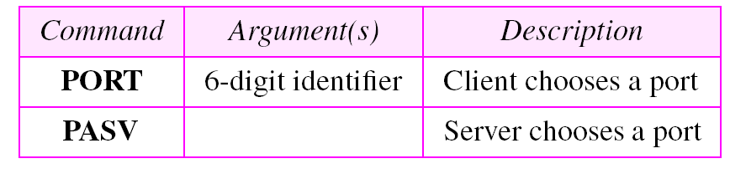
FTP – data formatting commands
Port definition commands

Slide 58
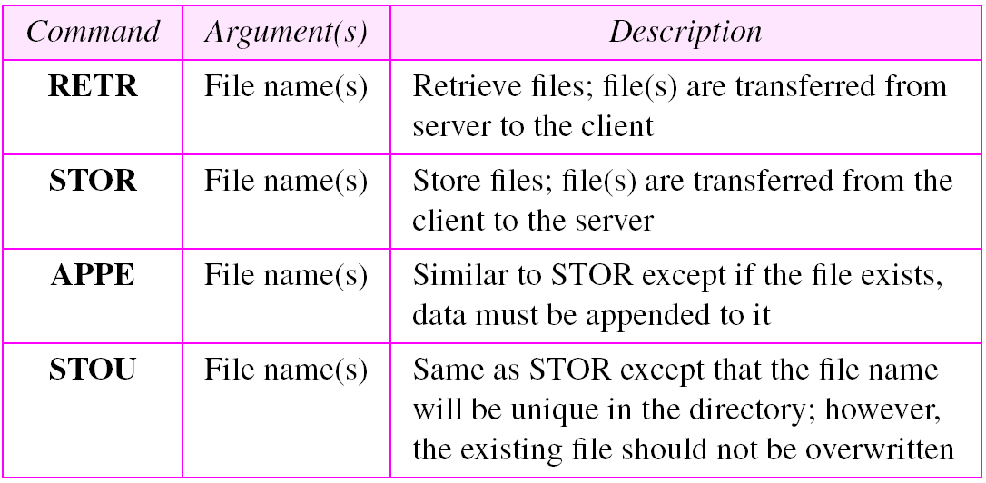
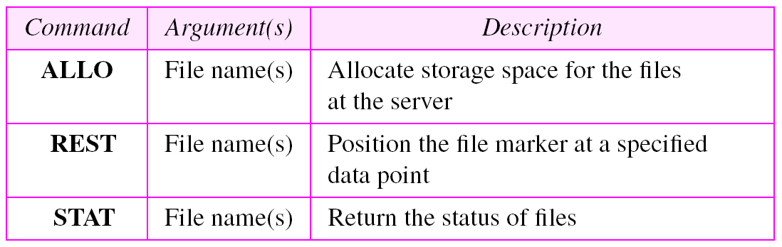
FTP – file transfer commands

Slide 59
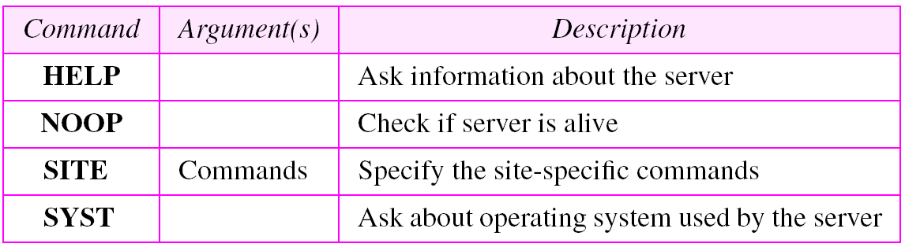
FTP – Miscellaneous commands

Slide 60
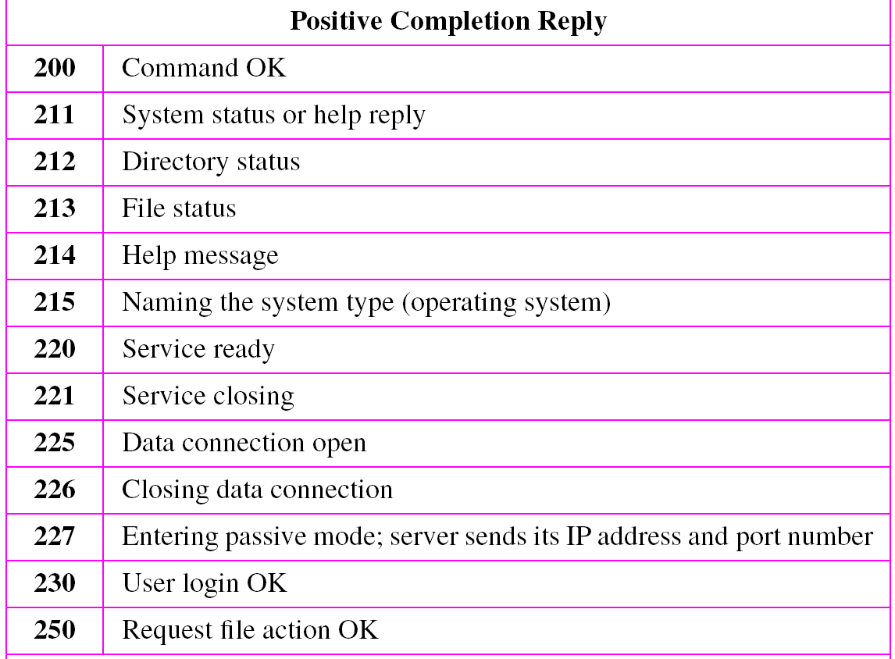
FTP – Some responses

Slide 61
What is a socket?
An interface between application and network
  The application creates a socket
  The socket type dictates the style of communication
    reliable vs. best effort
    connection-oriented vs. connectionless
Once configured, the application can
  pass data to the socket for network transmission
  receive data from the socket (transmitted through the network by some other host)
Notes:
TLI ( Transport Layer Interface )

Slide 62
Client-server applications
Simple idea:
Some hosts (clients, typically desk top computers) are specialized to interact with users:
Gather input from users
Present information to users
Other hosts (servers) are specialized to manage large data, process that data
The Web is a good example: Client (Browser) & Server (HTTP server)
Server socket address
208.216.181.15:80
Client socket address
128.2.194.242:3479
FTP Server
(port 21)
Client
HTTP Server
(port 80)
Connection socket pair
(128.2.194.242:3479, 208.216.181.15:80)
Client host address
128.2.194.242
Server host address
208.216.181.15

Slide 63
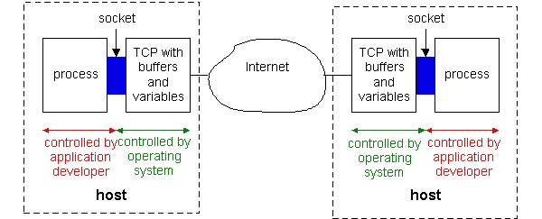
Socket Programming with TCP
Figure : Processes communicating through TCP sockets
The application developer has the ability to fix a few TCP parameters, such as maximum buffer and maximum segment sizes.

Slide 64
Sockets for server and client
Server
  Welcoming socket
    Welcomes some initial contact from a client.
  Connection socket
    Is created at initial contact of client.
    New socket that is dedicated to the particular client.
Client
  Client socket
    Initiate a TCP connection to the server by creating a socket object. (Three-way handshake)
    Specify the address of the server process, namely, the IP address of the server and the port number of the process.

Slide 65
Socket functional calls
socket (): Create a socket
bind(): bind a socket to a local IP address and port #
listen(): passively waiting for connections
connect(): initiating connection to another socket
accept(): accept a new connection
Write(): write data to a socket
Read(): read data from a socket
sendto(): send a datagram to another UDP socket
recvfrom(): read a datagram from a UDP socket
close(): close a socket (tear down the connection)

Slide 66
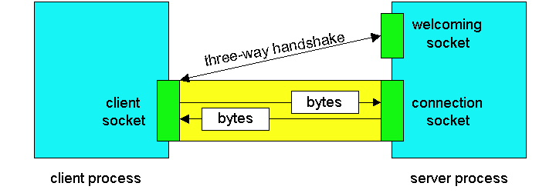
Sockets

Slide 67
Socket-programming using TCP
socket( )
bind( )
listen( )
server
client
socket( )
bind( )
connect( )
TCP conn. request
TCP ACK
accept( )
send( )
recv( )
recv( )
close( )
send( )
close( )
controlled by
application
developer
process
process
socket
TCP with
buffers,
variables
socket
controlled by
operating
system
TCP with
buffers,
variables
internet

Slide 68

Socket programming with TCP
Example client-server app:
client reads line from standard input (inFromUser stream) , sends to server via socket (outToServer stream)
server reads line from socket
server converts line to uppercase, sends back to client
client reads, prints modified line from socket (inFromServer stream)
Client
process
Input stream:
sequence of bytes
into process
output stream:
sequence of bytes
out of process
client TCP socket

Slide 69
Client/server socket interaction: TCP
Server (running on hostid)
Client
create socket,
port=x, for
incoming request:
welcomeSocket =
ServerSocket()
TCP
connection setup
create socket,
connect to hostid, port=x
wait for incoming
connection request
connectionSocket =
welcomeSocket.accept()
clientSocket =
Socket()
send request using
clientSocket
read request from
connectionSocket
write reply to
connectionSocket
read reply from
clientSocket
close
connectionSocket
close
clientSocket

Slide 70
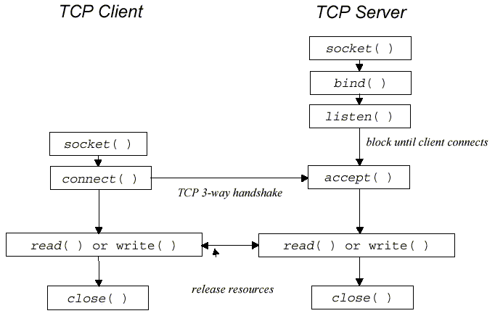
TCP Protocol

Slide 71
JAVA TCP Sockets
In Package java.net
  java.net.Socket
    Implements client sockets (also called just “sockets”).
    An endpoint for communication between two machines.
    Constructor and Methods
      Socket(String host, int port): Creates a stream socket and connects it to the specified port number on the named host.
      InputStream getInputStream()
      OutputStream getOutputStream()
      close()
  java.net.ServerSocket
    Implements server sockets.
    Waits for requests to come in over the network.
    Performs some operation based on the request.
    Constructor and Methods
      ServerSocket(int port)
      Socket Accept(): Listens for a connection to be made to this socket and accepts it. This method blocks until a connection is made.

Slide 72
TCPClient.java
import java.io.*;
import java.net.*;
class TCPClient {
public static void main(String argv[]) throws Exception
{
String sentence;
String modifiedSentence;
BufferedReader inFromUser =
new BufferedReader(new InputStreamReader(System.in));
Socket clientSocket = new Socket("hostname", 6789);
DataOutputStream outToServer =
new DataOutputStream(clientSocket.getOutputStream());

Slide 73
TCPClient.java
BufferedReader inFromServer =
new BufferedReader(new InputStreamReader(clientSocket.getInputStream()));
sentence = inFromUser.readLine();
outToServer.writeBytes(sentence + '\n');
modifiedSentence = inFromServer.readLine();
System.out.println("FROM SERVER: " + modifiedSentence);
clientSocket.close();
}
}

Slide 74
TCPServer.java
import java.io.*;
import java.net.*;
class TCPServer {
public static void main(String argv[]) throws Exception
{
String clientSentence;
String capitalizedSentence;
ServerSocket welcomeSocket = new ServerSocket(6789);
while(true) {
Socket connectionSocket = welcomeSocket.accept();
BufferedReader inFromClient = new BufferedReader(new
InputStreamReader(connectionSocket.getInputStream()));

Slide 75
TCPServer.java
DataOutputStream outToClient =
new DataOutputStream(connectionSocket.getOutputStream());
clientSentence = inFromClient.readLine();
capitalizedSentence = clientSentence.toUpperCase() + '\n';
outToClient.writeBytes(capitalizedSentence);
}
}
}

Slide 76
Socket Programming with UDP
UDP
  Connectionless and unreliable service.
  There isn’t an initial handshaking phase.
  Doesn’t have a pipe.
  transmitted data may be received out of order, or lost
Socket Programming with UDP
  No need for a welcoming socket.
  No streams are attached to the sockets.
  the sending hosts creates “packets” by attaching the IP destination address and port number to each batch of bytes.
  The receiving process must unravel to received packet to obtain the packet’s information bytes.

Slide 77

Example: Java client (UDP)
Client
process
Input: receives packet (UDP received “byte stream”)
Output: sends packet (UDP sent “byte stream”)
client UDP socket

Slide 78
Client/server socket interaction: UDP
Server (running on hostid)
Client
create socket,
port=x, for
incoming request:
create socket,
clientSocket =
DatagramSocket()
serverSocket =
DatagramSocket()
Create, address (hostid, port=x,
send datagram request
using clientSocket
read request from
serverSocket
write reply to
serverSocket
specifying client
host address,
port umber
read reply from
clientSocket
close
clientSocket

Slide 79
Additional slides

Slide 80

Types of address

Slide 81

Physical addresses (MAC Addresses)
In a node with physical address 10 sends a frame to a node with physical address 87. The two nodes are connected by a link (bus topology LAN). As the figure shows, the computer with physical address 10 is the sender, and the computer with physical address 87 is the receiver.

Slide 82
Physical addresses
Most local- area networks use a 48-bit (6-byte) physical address written as 12 hexadecimal digits; every byte (2 hexadecimal digits) is separated by a colon, as shown below
07:01:02:01:2C:4B
A 6-byte (12 hexadecimal digits) physical address.
for example, the MAC address 10101010.11110000.11000001.11100010.01110111.01010001 in binary can be represented as shorter hexadecimal equivalent AA.F0.C1.E2.77.51

Slide 83
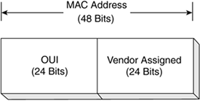
Notes:
. The vendor-assigned portion of the MAC address is just that, the alphanumeric identifier assigned by the vendor. It is the combination of the OUI and the vendor-assigned number that ensures that no two network adapters have the same MAC address.

Slide 84

Logical Address (IP addresses)

Slide 85
Example
Figure shows a part of an internet with two routers connecting three LANs. Each device (computer or router) has a pair of addresses (logical and physical) for each connection. In this case, each computer is connected to only one link and therefore has only one pair of addresses. Each router, however, is connected to three networks (only two are shown in the figure). So each router has three pairs of addresses, one for each connection.

Slide 86
IP address
The format of an IP address is a 32-bit numeric address written as four numbers separated by periods. Each number can be zero to 255. For example, 1.160.10.240 could be an IP address.
Format
x x x x x x x x . x x x x x x x x . x x x x x x x x . x x x x x x x x
where x is either 0 or 1
Example 1:
1 1 1 1 1 1 1 1 . 1 1 1 1 1 1 1 1 . 0 0 0 0 0 0 0 0 . 0 0 0 0 0 0 0 0
255.255.0.0
Example 2:
1 1 1 1 1 1 1 1 . 1 1 1 1 1 1 1 1 . 1 0 0 0 0 0 0 0 . 0 0 0 0 0 0 0 0
255.255.192.0

Slide 87

Port addresses

Slide 88
Port addresses
Figure shows two computers communicating via the Internet. The sending computer is running three processes at this time with port addresses a, b, and c. The receiving computer is running two processes at this time with port addresses j and k. Process a in the sending computer needs to communicate with process j in the receiving computer.
The physical addresses will change from hop to hop,
but the logical and port addresses usually remain the same.

Slide 89
Port addresses
A port address is a 16-bit address represented by one decimal number as shown.
753
A 16-bit port address represented
as one single number.
Ports 0 to 1024 are reserved for use by certain privileged services.

